Slide 1

Keystroke Behavioral Biometrics Continuous Authentication Approach Using ML Algorithms
TEAM MEMBERS
Mohammad AL Nawayseh
Nehad Dhoun
Salma Jedayah
Salsabeel Khaleel

Slide 2



Slide 3
Agenda
Introduction
Project
Proposed Model Methodology
Keystroke Dynamics Authentication Approach
Conclusions and Future work

Slide 4

Introduction

Slide 5
Authentication :
Authentication : The process of confirming a user's identity when they want to access a computer system or network.
Authentication Importance :
Authentication plays a crucial role in reducing the risk of data breaches and other security concerns associated with the increasing digital storage and exchange of data.
By ensuring that only authorized individuals can access the data, authentication helps mitigate these risks and safeguard sensitive information.

Slide 6
Authentication types :
Traditional Authentication : refers to the conventional methods of verifying a user's identity before granting access to a system or network. It involves using something the user knows like a password or PIN, or something the user has such as a physical token or smart card. These methods are widely used and include techniques like usernames , passwords, and one-time passwords (OTP) sent via SMS or email.
Continuous authentication : Continuous authentication is a type of authentication technology that continuously and in real-time verifies users' identities as they perform routine computer tasks using other compatible authentication mechanisms (such keystroke dynamics).

Slide 7
Authentication types :
Since continuous authentication recognizes the correct user throughout ongoing work, it is generally thought to be superior to traditional forms of (login-based) authentication. Login-based authentication only verifies a user's identity once, at the beginning of a login session.
Continuous authentication can thus detect the moment that an unauthorized attacker takes over the session, terminate it immediately, logging the account out, and protecting important systems and data.

Slide 8
Authentication methods :
Traditional authentication methods: involve the use of something the user knows, such as a PIN, a pattern, or a password. However, these methods can be easily forgotten or vulnerable to attacks such as guessing attacks ,smudge attacks and shoulder surfing . Despite being quick, simple, and inexpensive, these methods are not impervious to attack.
Biometric-Based Authentication : is a method of verifying an individual's identity based on their distinct physical or behavioral traits.
Physical Biometric Authentication ( Static )
Behavioral Biometric Authentication ( Dynamic)

Slide 9

Keystroke
Keystroke: often called a key press, is the action of pressing a key on a keyboard or other input device.
Keystroke As a Behavioral Biometrics : Keystroke dynamics, another name for typing biometrics, is a behavioral biometric system that verifies an individual's identity by using the features of their typing habit.

Slide 10
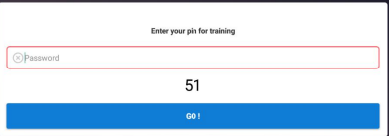
Keystroke Authentication :
Keystroke authentication is a biometric-based authentication technique that identifies users by their unique typing patterns .
1- Fixed text Keystroke ( Static )
Enter a pre-set text.
Text is constant

Slide 11
Keystroke:
2- Free text
users type either lengthy pieces of text that mimic the concept of free text
type anything, they want whenever they want with no restrictions.
When users are later need to be recognized, they may provide the same text or a completely different text.
HI ,,, Feel Free Say what you want !!
Salma 2002200@

Slide 12
Summary
Authentication is a crucial process for confirming a user's identity when accessing computer systems or networks. It helps mitigate the risks of data breaches and enhances security measures.
Traditional authentication methods involve using something the user knows (like a password) or something the user has (like a physical token).
Continuous authentication verifies users' identities in real-time during their computer tasks.
Biometric-based authentication utilizes physical or behavioral traits for identity verification.
Keystroke dynamics, a behavioral biometric, analyzes typing patterns to create unique typing profiles for users. Keystroke authentication techniques include fixed text (using preset samples) and free text (allowing users to type freely).

Slide 13

PROJECT

Slide 14
Problem Statement
With the widespread use of smartphones for personal and professional purposes, ensuring the security of user data has become a crucial concern. Traditional password-based authentication systems can be vulnerable to attacks such as phishing and brute force attacks. Also, Traditional biometric authentication methods have limitations such as false positives, false negatives, and spoofing attacks. Continuous authentication based on free text keystroke behavioral biometrics offers a more secure and reliable alternative. However, static keystroke patterns may not be enough to distinguish between genuine and fraudulent users. This project aims to develop a keystroke behavioral biometrics continuous authentication approach that addresses these limitations by analyzing free-text keystroke dynamics patterns using machine learning algorithms. The proposed approach aims to provide a more secure and reliable authentication method for various applications, such as smartphone authentication, online transactions and accessing sensitive information.

Slide 15
Motivation
The motivation for this project come from the need for improved authentication techniques for smartphones . Current authentication techniques are vulnerable to unauthorized access and lack real-time intrusion detection , creating threats to user privacy and security . Fortunately , a more robust and continuous authentication system for smartphones can be created by combining keystroke dynamic and ML , which offers improved security and user experience on smartphones.

Slide 16
Objectives And Goals
The main objective of this project is the implementation of a continuous authentication model based on free-text keystroke dynamics using Machine Learning Algorithms. The following objectives are taken into consideration:
Analysis of Keystroke dynamics data to identify the collection of features that will improve the proposed model's ability to identify unauthorized entry attempts.
Present and evaluate the effectiveness of Keystroke dynamics selected features through a unimodal using ML.
Conduct a thorough comparison of the proposed mode with others Machine Learning Algorithms regarding the goal of superiority demonstrating.

Slide 17

Proposed Model Methodology

Slide 18
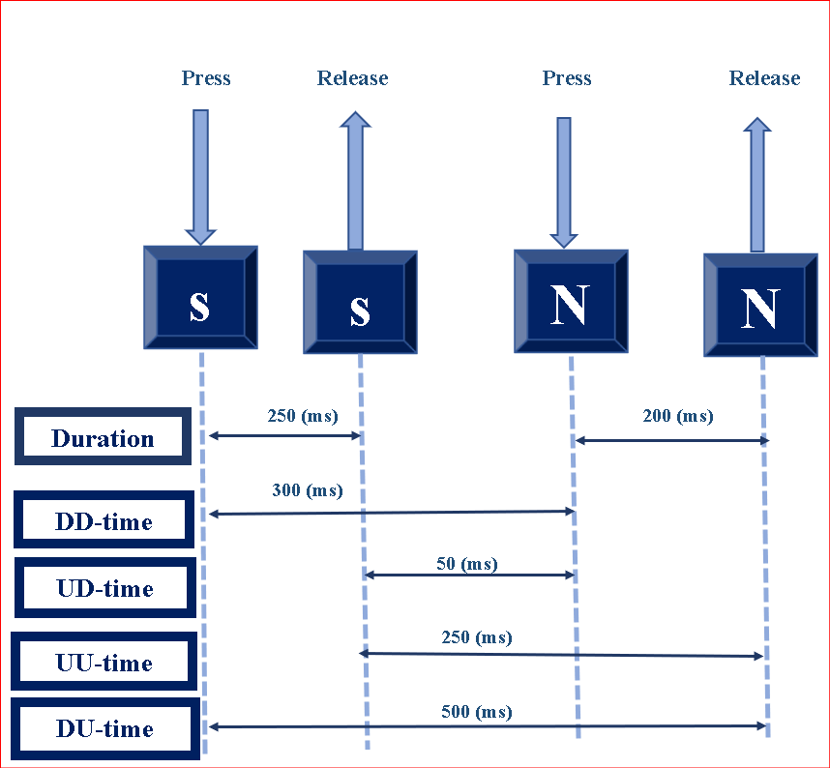
Keystroke Dynamics
Keystroke dynamics KD commonly include analyzing the time characteristics such as key press or release duration and their latencies.

Slide 19

Dataset
The BB-MAS (Behavioral Biometrics Multi-device and Multi-Activity data from Same users) , 2019
The proposed uni-modal approach depends on using 56 users' data from BBMAS dataset .
( 22400 samples , 56 users * 400 )
Balanced ( 400 samples for each user )
Multiclass ( 56 Subject )

Slide 20
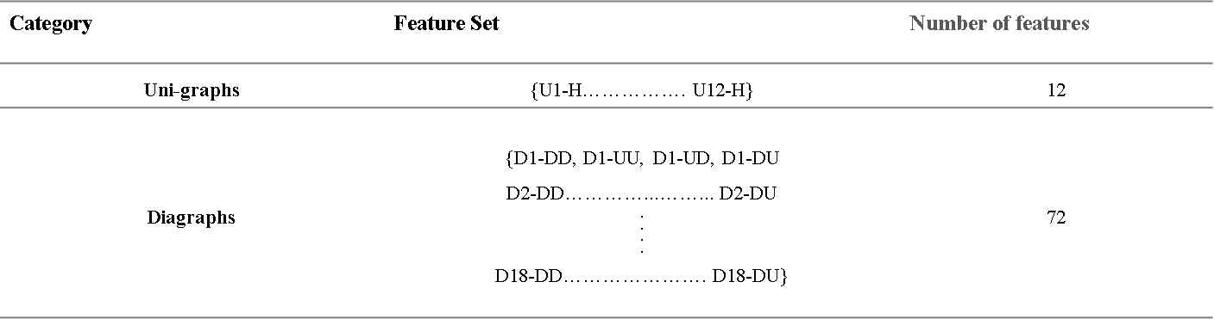
Data Feature Extraction And Pre-processing
The feature extraction method proposed in ([7]) is applied in this project

Slide 21
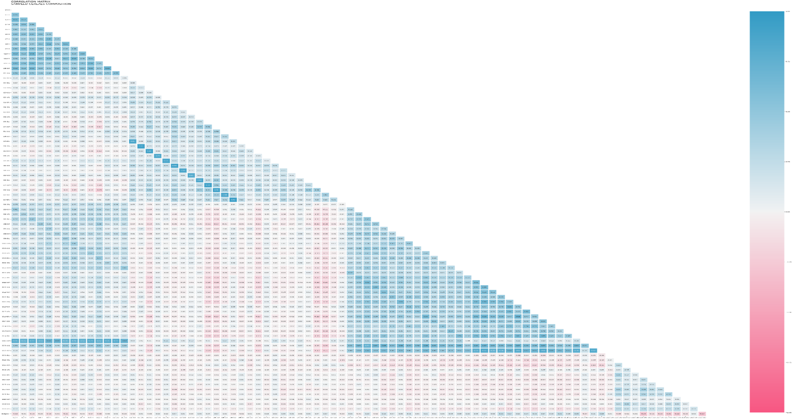
Keystroke features HEATMAP

Slide 22
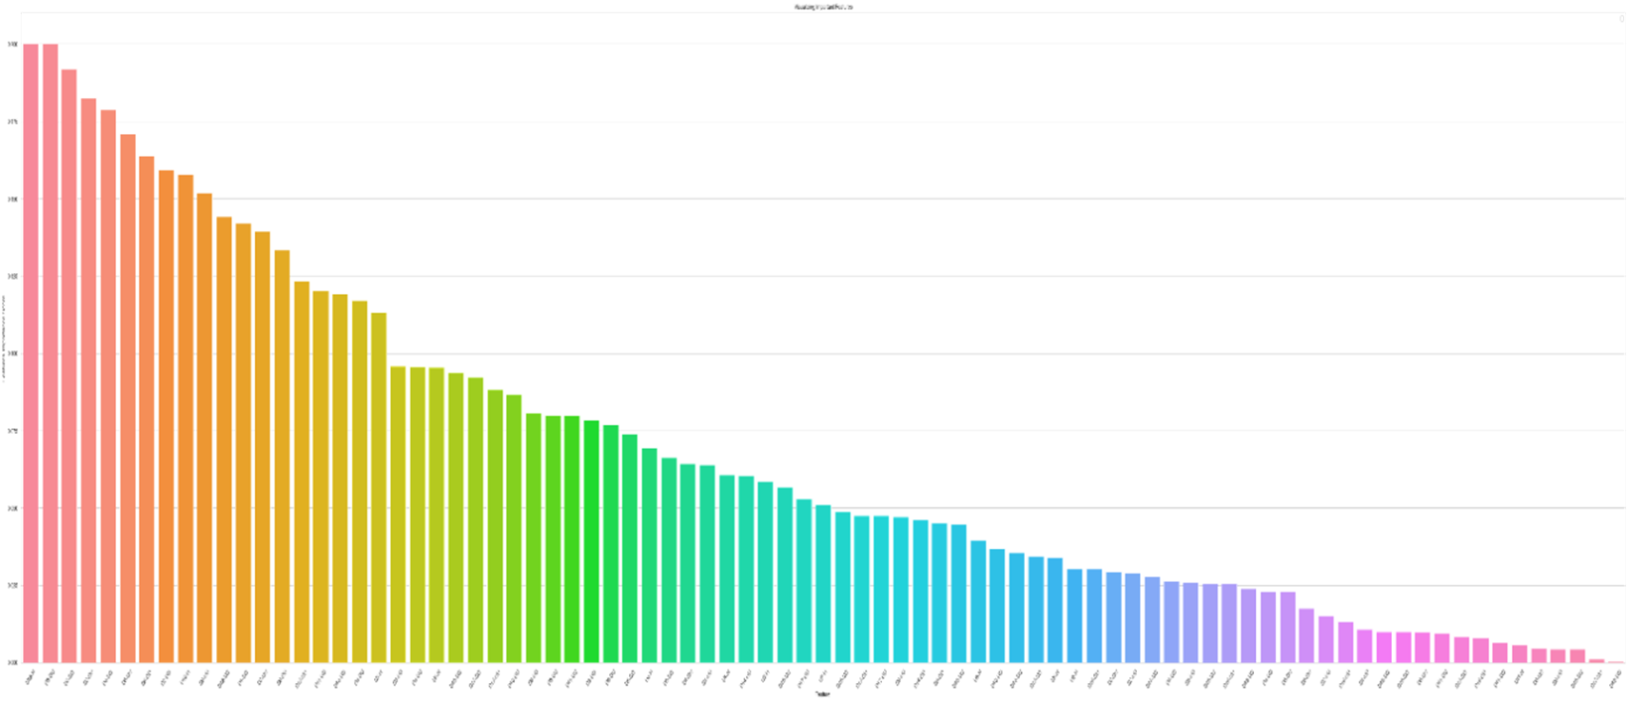
Keystroke Features Importance

Slide 23

Feature Selection And Classification Methods
 | classifier | ACC% | F1 score | Recall | Precision
1 | Random Forest | 0.999 | 0.999 | 1 | 1
2 | K-Nearest Neighbors | 0.997 | 0.997 | 0.998 | 0.998
3 | XGBoost Classifier | 0.995 | 0.995 | 1 | 1
4 | Support Vector Machine | 0.989 | 0.989 | 0.993 | 0.993
5 | Multi-layer Perceptron | 0.989 | 0.989 | 1 | 1
6 | Naive Bayes Classifier | 0.969 | 0.969 | 0.976 | 0.976
7 | Logistic Regression | 0.962 | 0.962 | 0.97 | 0.97
8 | Decision Tree | 0.907 | 0.907 | 1 | 1

Slide 24
Feature Selection with Classifiers
 |  | ANOVA | IMPORTANCE | CORRELATION
Random Forest | Accuracy % | 99.04 | 99.97* | 99.97
 | Number of features | 76 | 30* | 43
 | Time | 1.14 | 2.11* | 11.45
K-Nearest Neighbors | Accuracy % | 99.77 | 99.83 | 99.77
 | Number of features | 76 | 30 | 43
 | Time | 0.56 | 1.78 | 15.92
XGBoost Classifier | Accuracy % | 99.21 | 99.89 | 99.75
 | Number of features | 61 | 30 | 43
 | Time | 490.31 | 4.98 | 12.60

Slide 25
Selected Features
Category | Selected Features |  | Number
Uni-graph | { “U11-H" , "U3-H"} |  | 2
Diagraph | {"D15-DD","D15-UD","D15-UU","D6-UD","D3-UU","D10-DD","D3-UD","D5-UU","D2-DD","D6-DU","D4-UD","D7-DD","D4-UU","D7-UD","D7-DU","D4-DD","D5-DD","D7-UU","D1-DU","D3-DU",D2-DU","D6-DD","D1-UD","D10-DU","D3-DD",D4-DU","D6-UU","D5-UD"} |  | 28
 |  | Total | 30

Slide 26

Keystroke Dynamics Authentication Approach

Slide 27
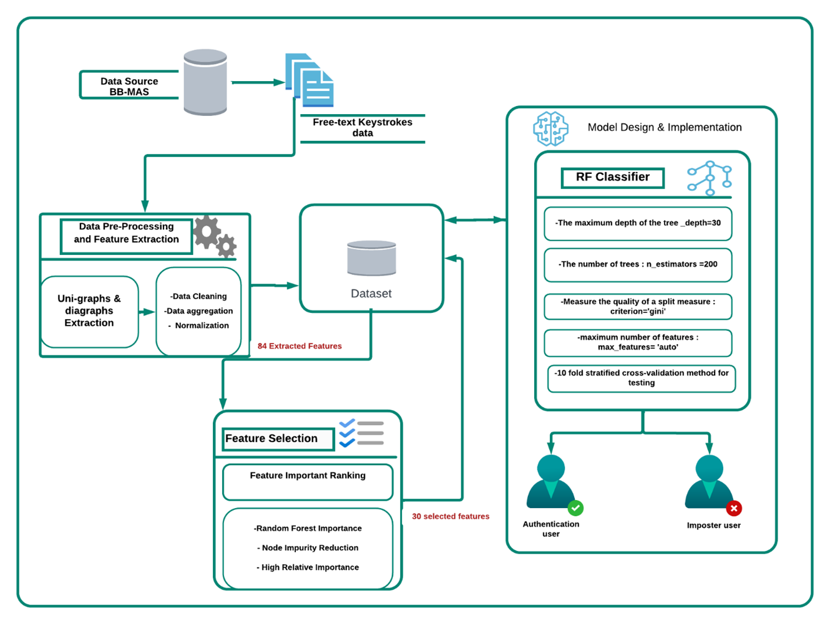

Slide 28
KD Approach Evaluation Metrics of Multiple Classifiers
Classifier | Accuracy (%) | Precision (%) | Recall (%) | F-Measure (%) | FAR (%) | FRR (%) | Error Rate (%)
Random Forest* | 99.97 | 99.97 | 99.96 | 99.30 | 0.00 | 0.00 | 0.02
K-Nearest Neighbors | 99.84 | 99.82 | 99.83 | 95.47 | 4.49 | 0.8 | 1.06
XGBoost | 99.89 | 99.87 | 99.86 | 96.84 | 3.15 | 0.6 | 0.14

Slide 29
Conclusions and Future Work
Methods for improving smartphone continuous user authentication were introduced in this project . it was a uni-modal approach based on free-text keystroke dynamics.
The proposed uni-modal approach depends on using 56 users' data from BBMAS dataset .
Random Forest classifier with a feature-importance feature selection method was used to create the user authentication model based on keystroke dynamics.
With only 30 features out of the 84 features in the dataset, exceptional performance was achieved with a detection accuracy of 99.97% and 0% for both FRR and FAR with the least EER.
Based on the obtained data, our model proved to be superior when compared with other well-known ml classifiers and previous studies.

Slide 30
Conclusions and Future Work
future work will include implementing additional studies to obtain a fresh dataset by extending the participant pool and to cover more complex scenarios with many languages. inquire as to whether deep learning techniques will help accuracy and other evaluation criteria even more.

Slide 31
THANK YOU

